Slide 1


Slide 2

WALK WITH ME is a tool for churches and organisations with a passion to see young people stepping closer to Jesus.
It enables them to support young people, aged 14+, to meet in ones or twos with a committed Christian.
They meet for an hour every couple of weeks to catch up, discuss the bible, and pray.

Slide 3
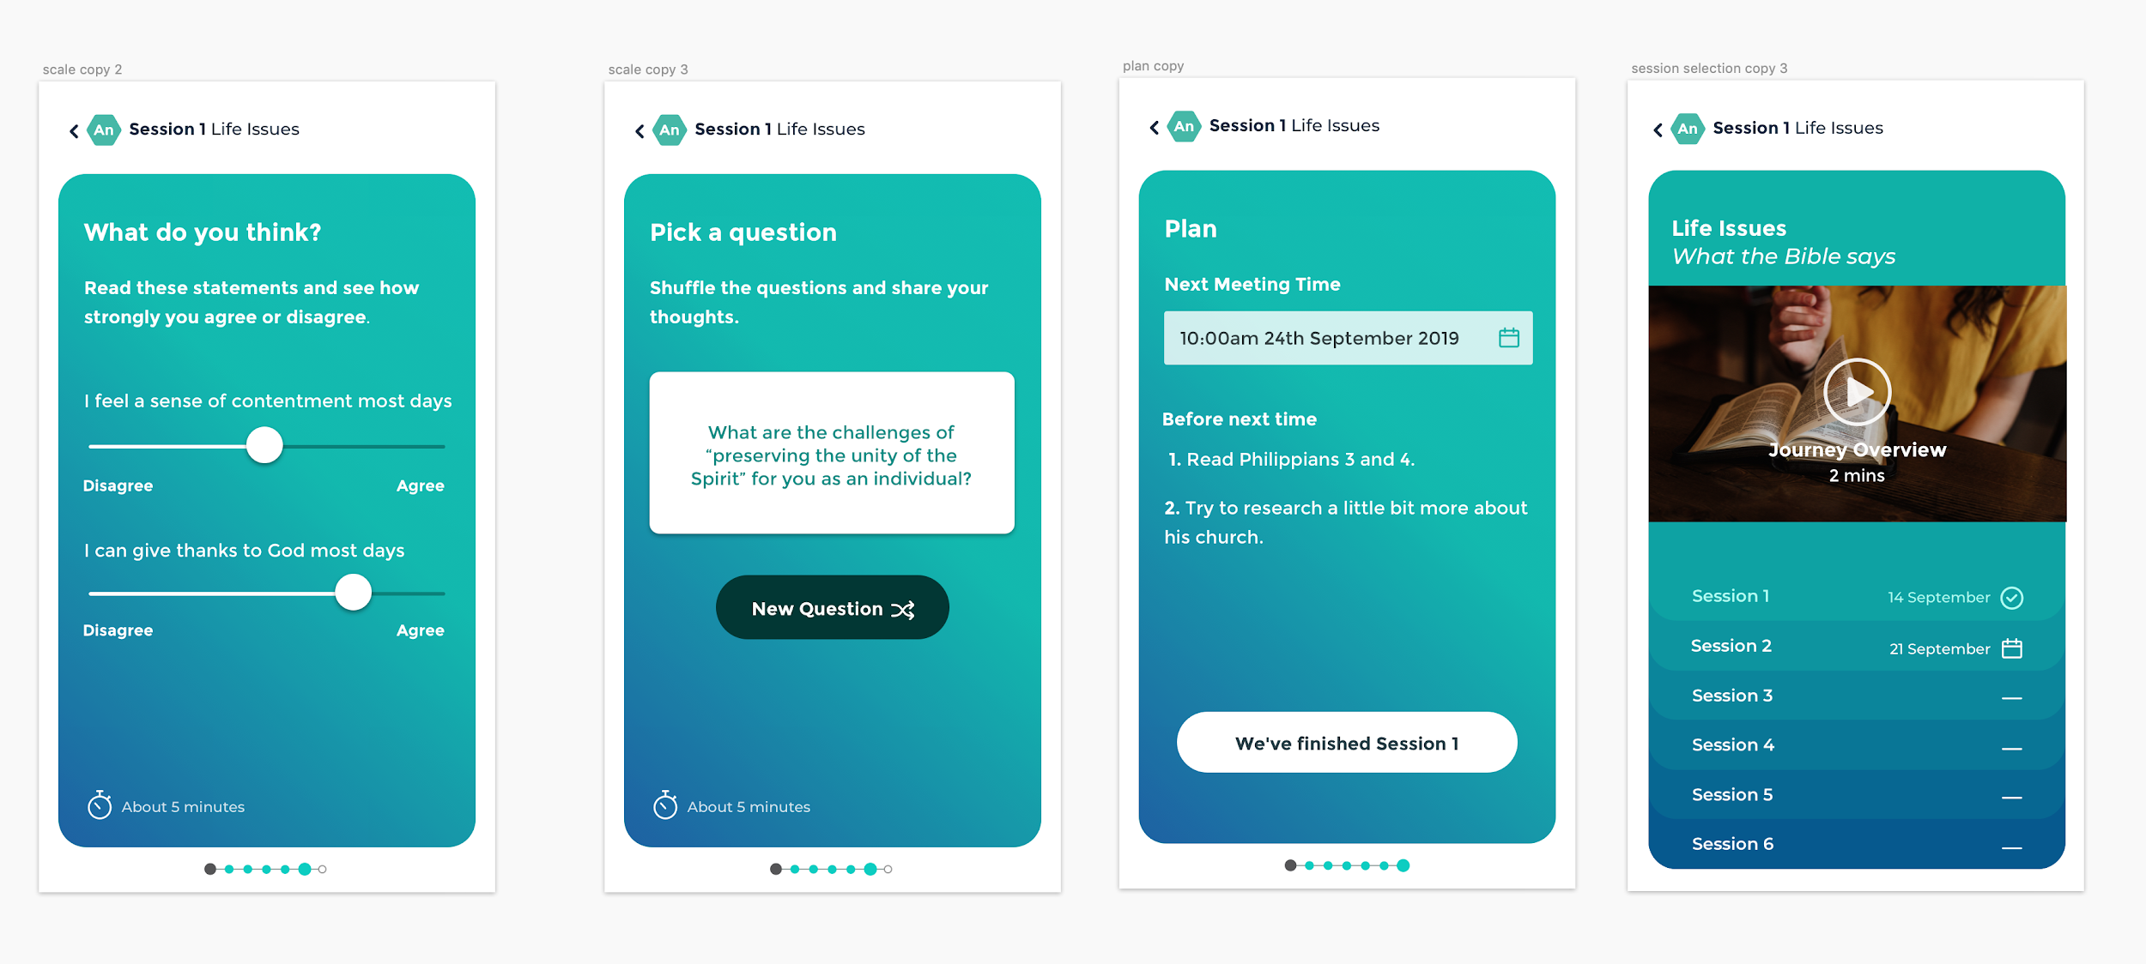
WHAT’S PROVIDED?
A Mentor’s App
Provides mentors with great questions and Biblical content to give a simple framework to their time with young people.

Slide 4
WHAT’S PROVIDED?
A Range of Journeys
The app contains a choice of 6-session courses to suit young people at different stages:
Discovering who I am
Exploring who Jesus is
I’ve become a Christian
Following Jesus Wholeheartedly
Joining God’s Mission
Becoming a Disciple Maker

Slide 5
WHAT’S PROVIDED?
Online Support
Everything your church, group or organisation needs to run the programme.
Training Resources
Good Practice Guidelines
Personal Login to connect mentors with their local church or organisation

Slide 6
GET STARTED
WALKWITHMEJOURNEYS.ORG
Sign up to receive step by step information on how to launch WALK WITH ME in your setting
Envision > Invite > Prepare > Launch > Walk

Slide 7
Developed in partnership between Irish denominations and youth ministry agencies
CIYD / Exodus / GB / IMYC / SUNI / Urban Saints /
YFCNI / Youth Initiatives / Young Life International
Notes:
Core Content
Inspiration - A vision of the potential of mentoring.
Overview - Understanding the process / journey
Guidance - Identifying a potential Mentee
Good Practice - e.g. safeguarding
Journeys
A range of mentoring “journeys” to suit a particular context
Each journey contains 6 sessions built around 6 steps:
Preparation / Connection / Bible / Prayer / Next Steps / Review
Connection
Chat and Notifications from real person
Support & Encouragement to keep going
Tips / creative ideas
Opportunity to feedback or share tips with other mentors.
Additional Resources
A website to explain the process and help a church or group get started.
A physical version of some or all of the Journeys from the app.

